Slide 1

Telecom Churn Prediction
Presented by Nicole Shen

Slide 2

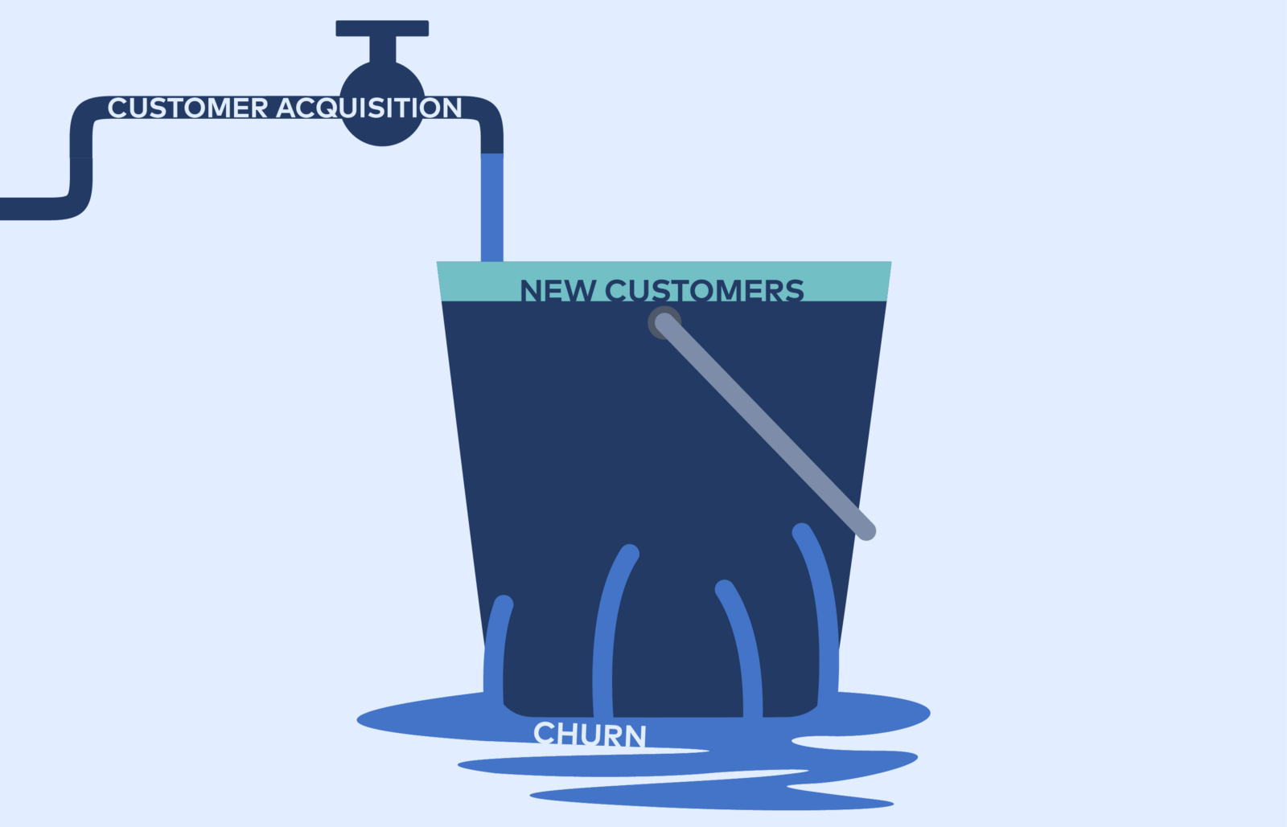
Introduction
Customer churn major concerns in large telecom industries.
Main strategies to acquire customers:
Acquire new customers
Upsell the existing customers
Increase the retention period of customers
Remaining existing customer costs lower
Objective: Churn Prediction

Slide 3
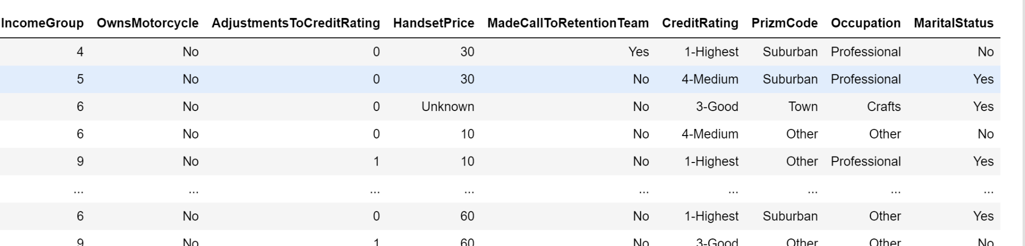
Dataset
Csv file
Size: 51047 row * 58 column
Label: Churn
Features: customerid, monthly revenue, and related data
●Evaluate if the model can generalize/predict new data well
○Metrics: recall, precision, accuracy, f1

Slide 4
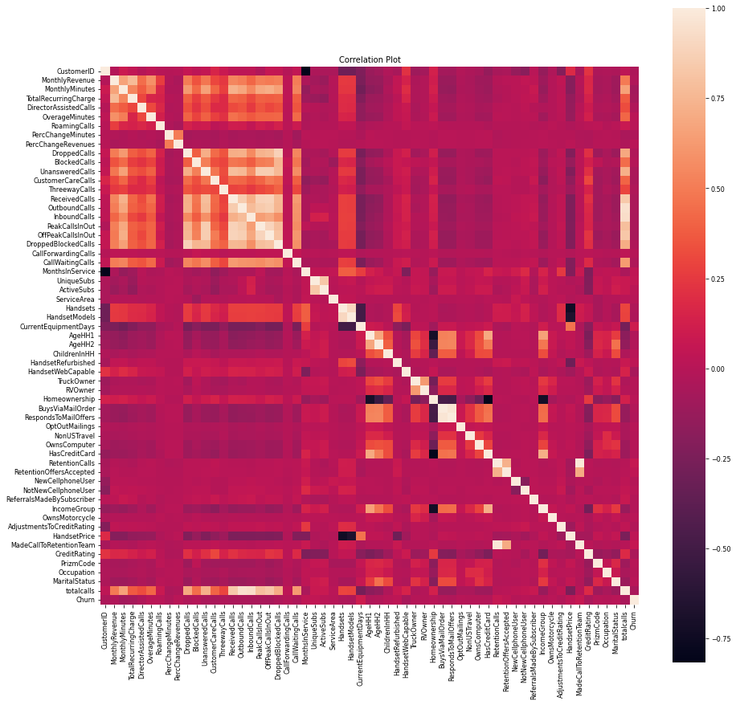
Data Cleaning
●Rename columns
●Remove duplicates
○Duplicate rows
○Duplicate columns
●Handle missing value
○Drop NaN values
●Profile Report
○Distinct values in categorical columns
●Correlations
○Heatmap

Slide 5
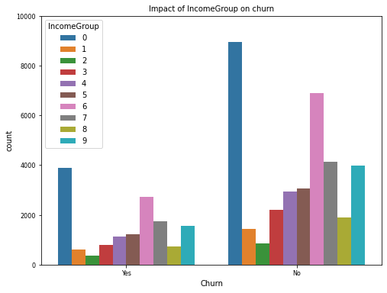
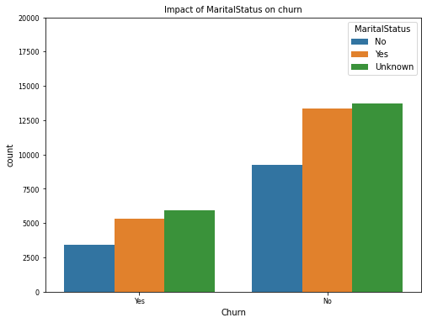
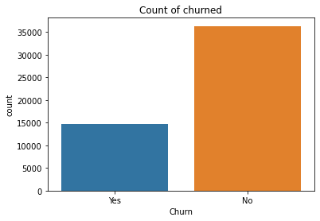
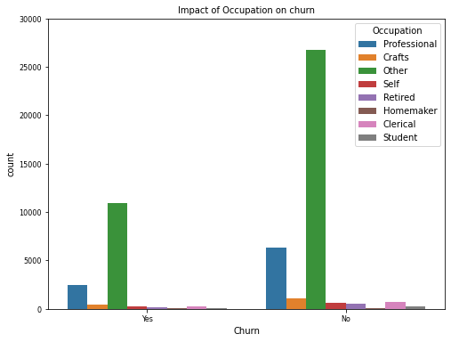
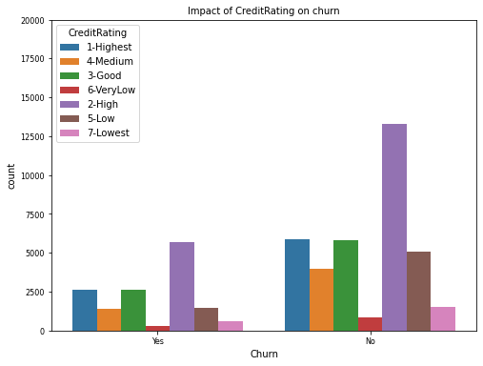
EDA
Visualization
●Bar charts
●Histograms

Slide 6
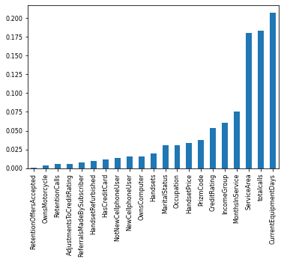
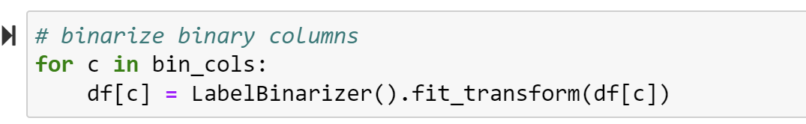
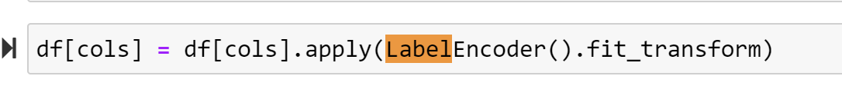
Feature Engineering & Feature selection
●Create New Features
○Total calls = Outbound calls + Inbound calls
●Feature Selection
○Select and fix top 9 features
○add/delete features while modeling
●Encoding : Convert categorical data to numeric data
○Target Encoding
○Category Codes
○Replace methods
●Resampling Imbalance Data:
○RandomUnderSampler
○RandomOverSampler
●Scaling Data:
○StandardScaler/MinMax

Slide 7
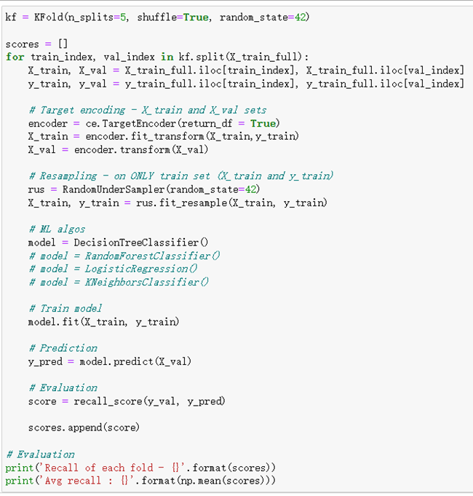
Modeling Considerations
●Validation methods
○train_test_split
○k-fold cross validation
○Pipeline + Gridsearch
●ML algorithm & Hyperparameter tuning
○Decision Tree
○Random Forest
○Logistic Regression
○KNeighbors
○SVC
●Train & Prediction
○fit train set to predict val set
○refit to train_full set
○apply best model to predict test set
●Evaluation matrix
○ Classification report (f1, recall, precision, accuracy)
●Interpretation
dt.feature_importance_

Slide 8
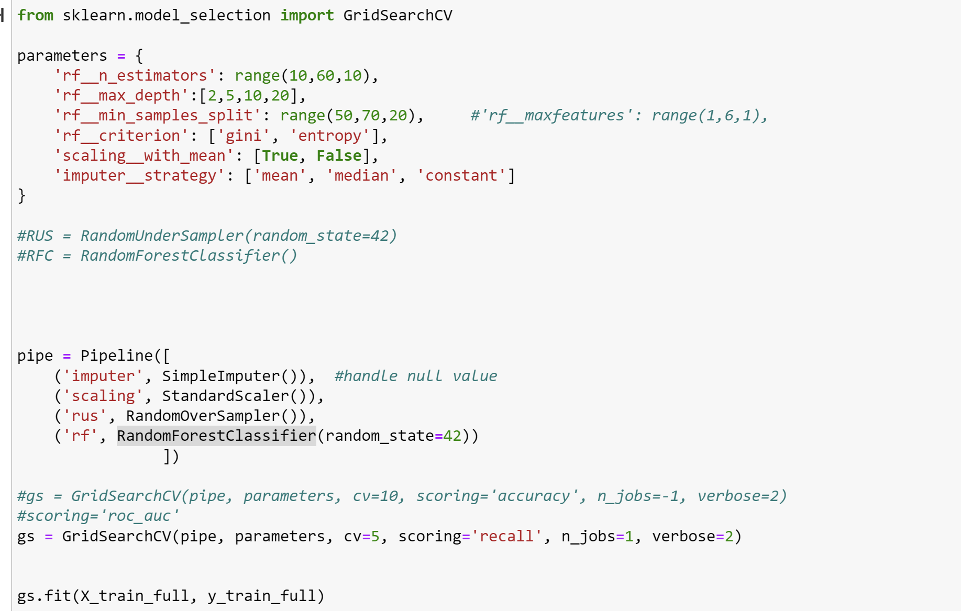
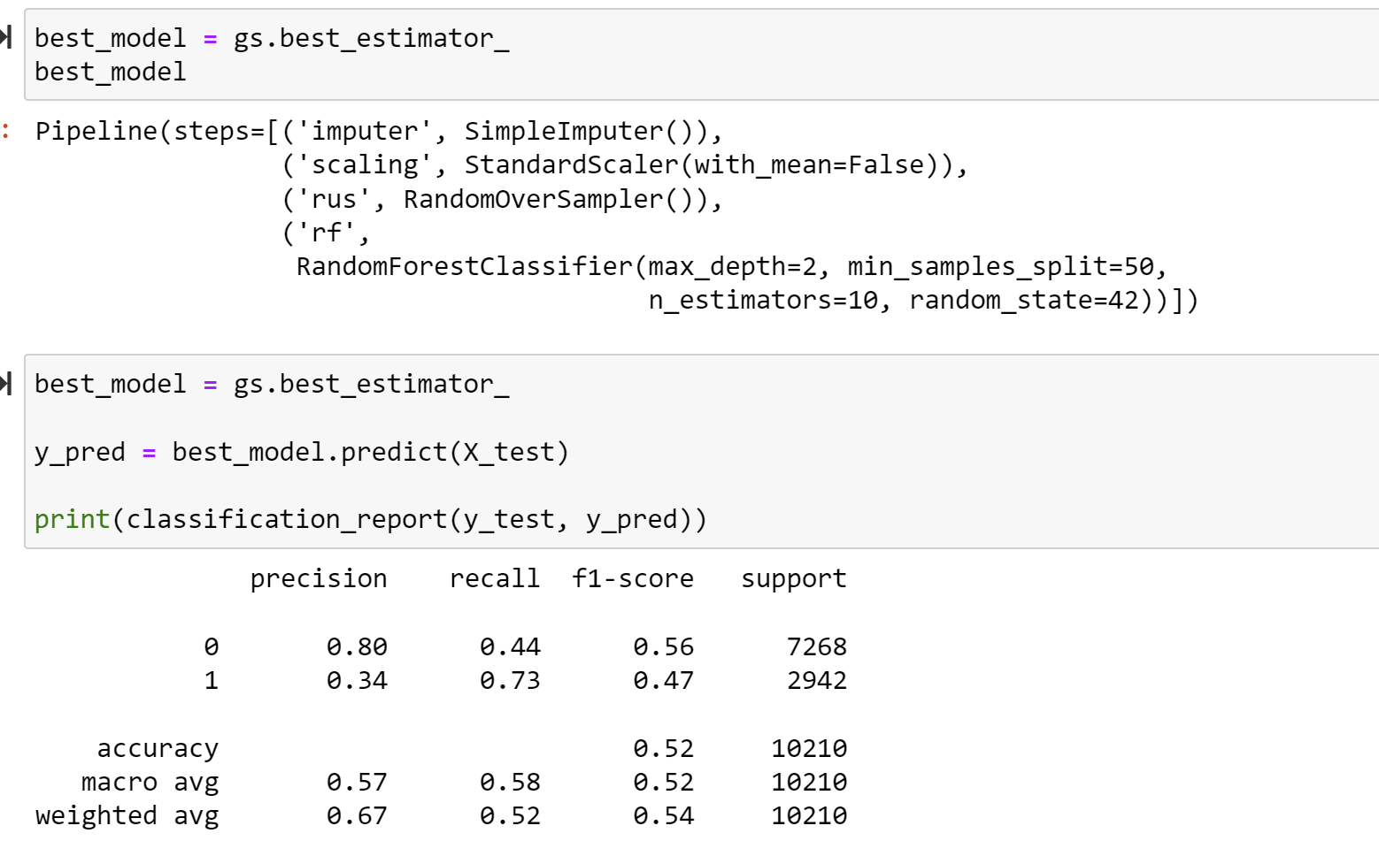
Machine Learning Best Model
●Feature Selection
○Features: top 9
○Fillna (0)
●Pipeline in Gridsearch
○LabelEncoder()
○StandardScaler()
○RandomUnderSampler(random_state = 42)
○Estimator: Decision trees
■max_depth=3,
criterion='entropy'
●Evaluation Matrix
○Accuracy = 0.71
Estimator: RandomForestClassifier
○Recall=0.58

Slide 9
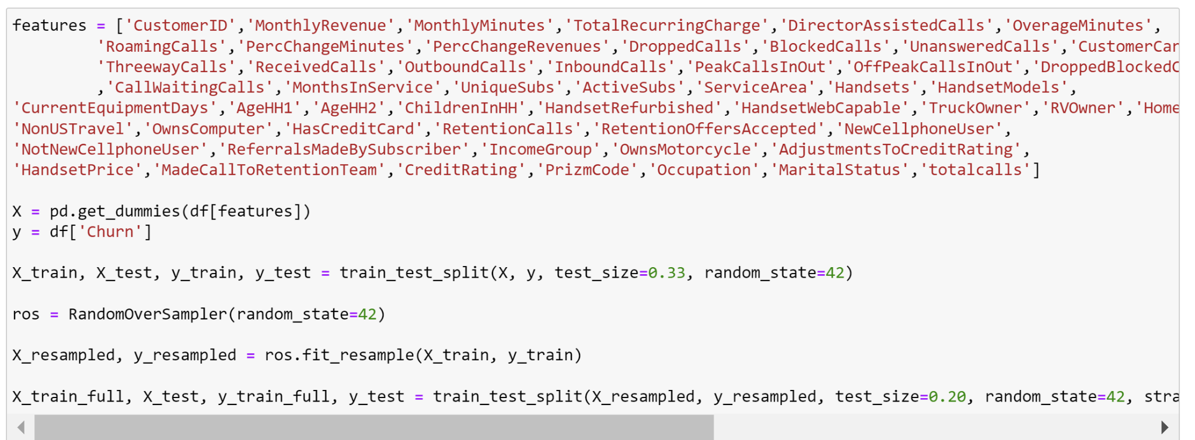
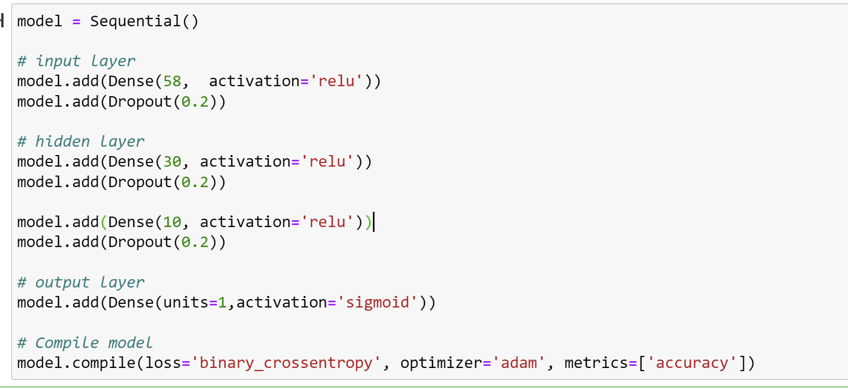
Deep Learning

Slide 10
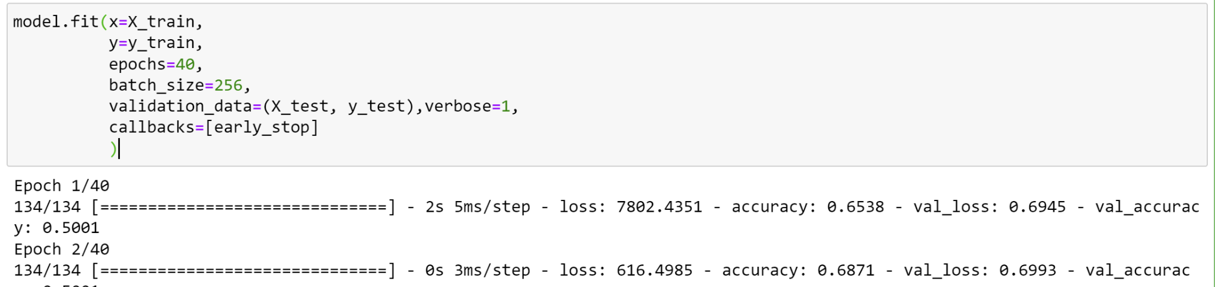
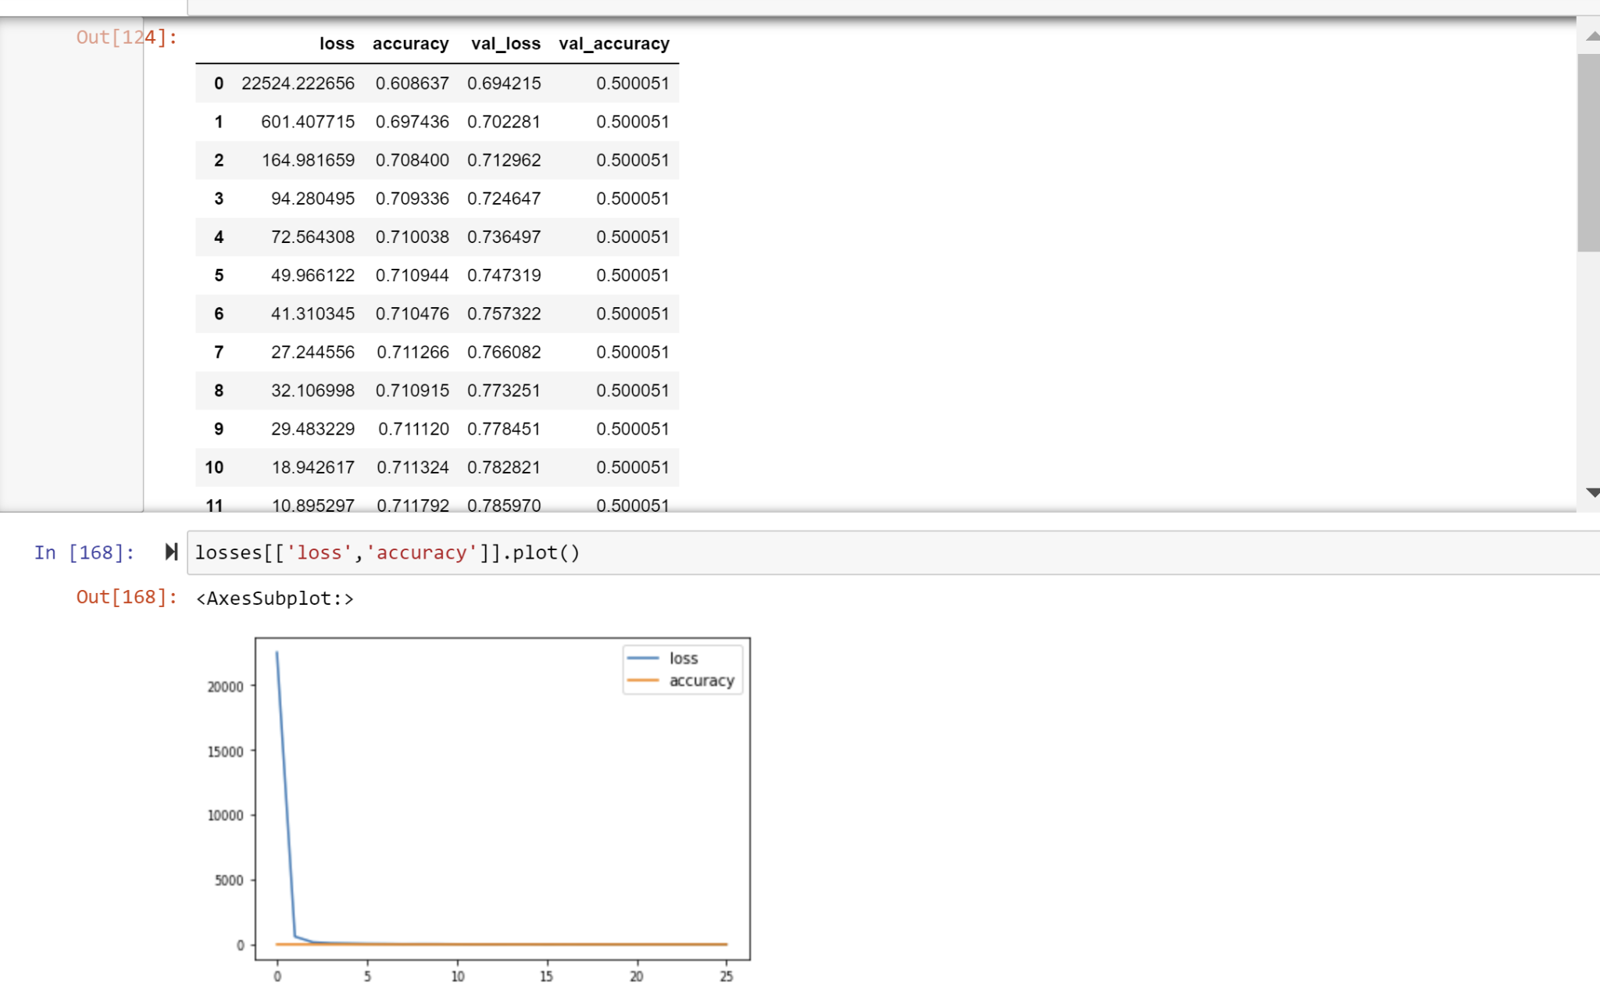
Deep Learning

Slide 11
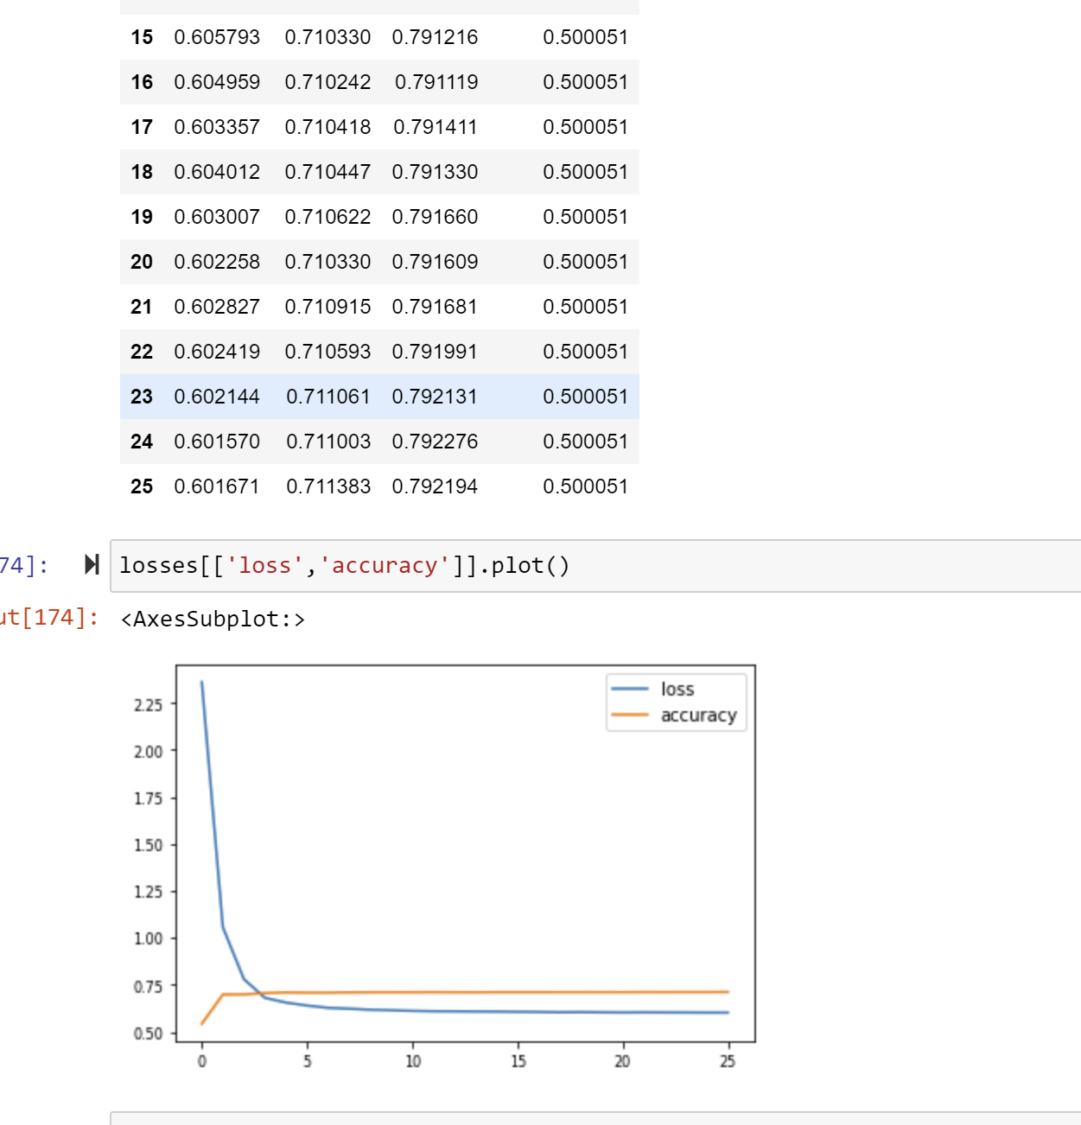
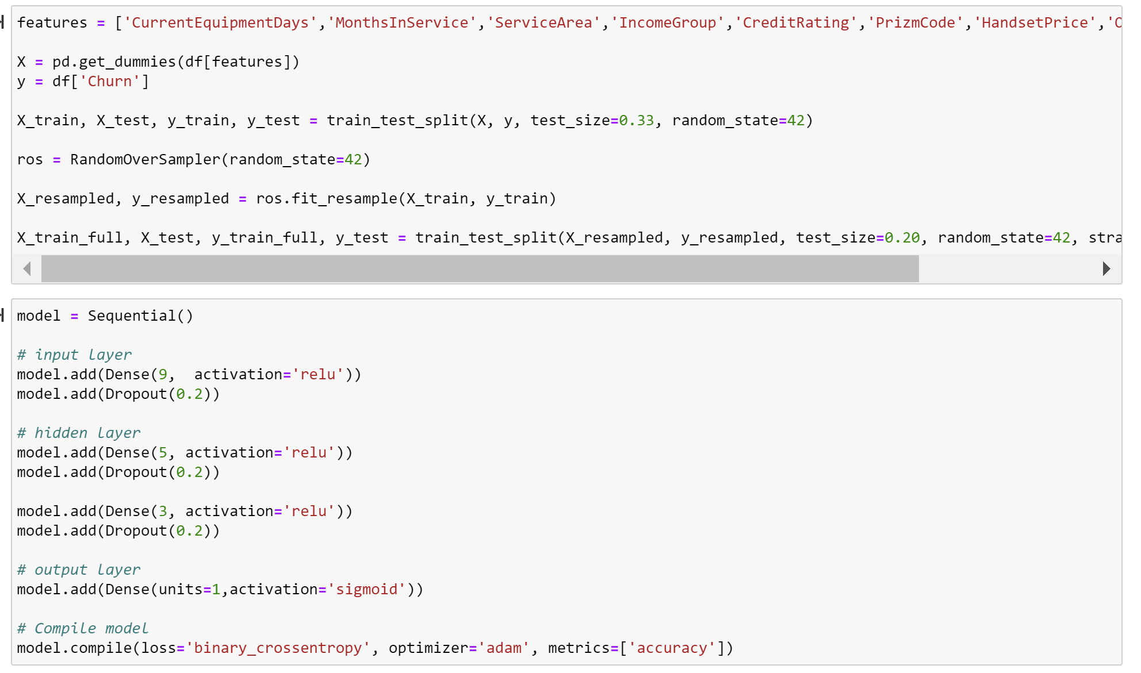
Deep Learning

Slide 12

Conclusion & Next Step
ML vs DL:
Metrics comparison
Speed
Next Step:
PCA
Deep Learning CNN

